Slide 1

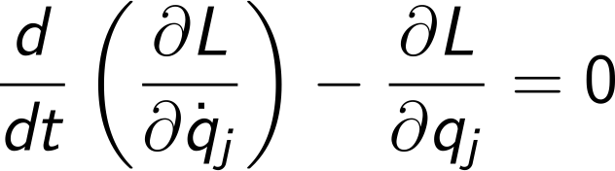
Computational Physics (PHYS6350)
Lecture 13: Classical mechanics problems
Instructor: Volodymyr Vovchenko (vvovchenko@uh.edu)
Course materials: https://github.com/vlvovch/PHYS6350-ComputationalPhysics
Online textbook: https://vovchenko.net/computational-physics/

Slide 2
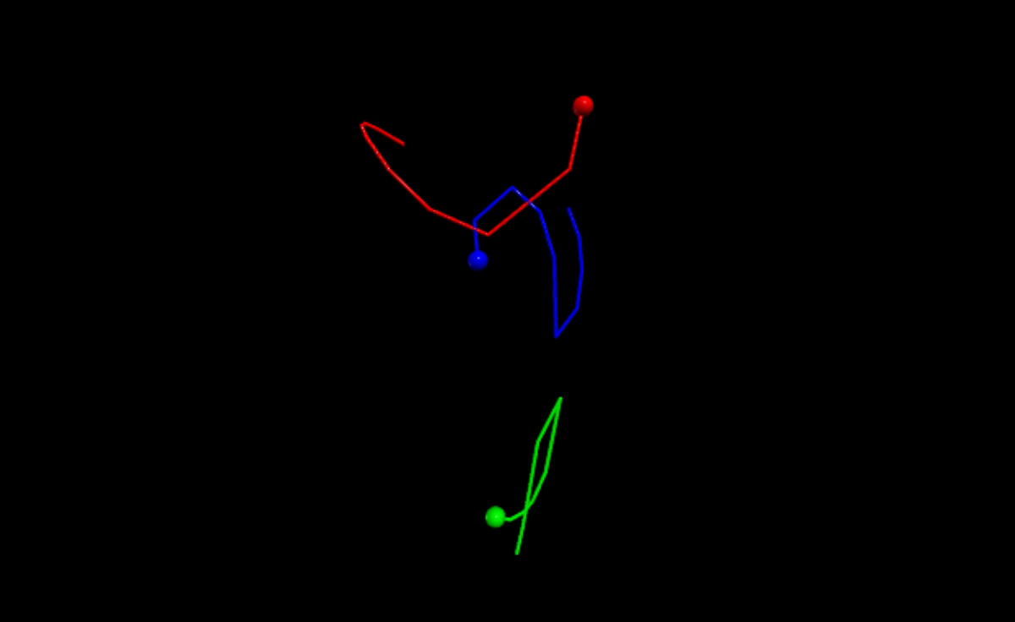
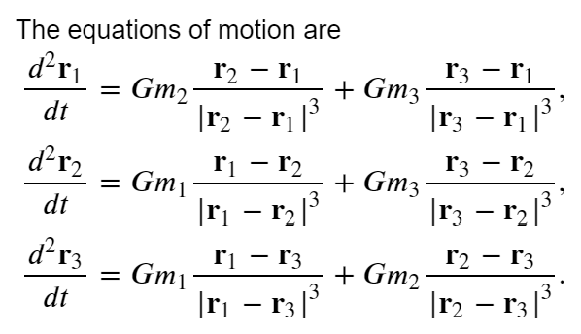
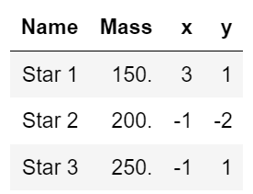
Three-body problem
Exercise 8.10 (M. Newman, Computational Physics)
Three stars interacting through gravitational force
Cannot be solved analytically!
Take G = 1 (dimensionless)
Initially at rest and move in plane z = 0
Initial coordinates: r₁ = (3,1), r₂ = (-1,-2), r₃ = (-1,1)

Slide 3
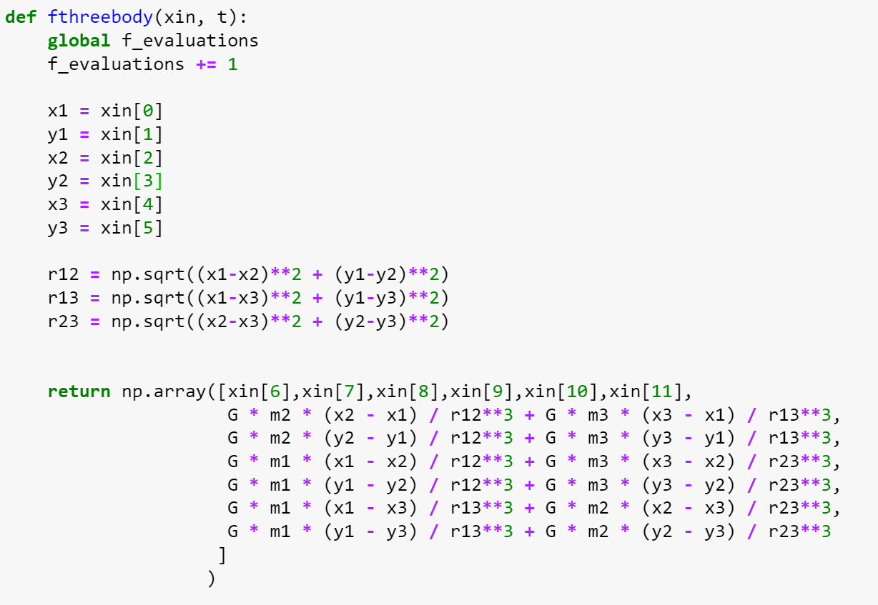
Three-body problem
Run from t = 0 to 5

Slide 4
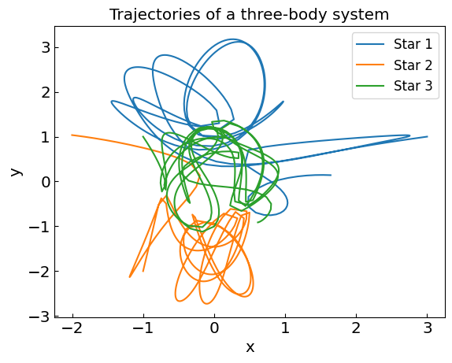
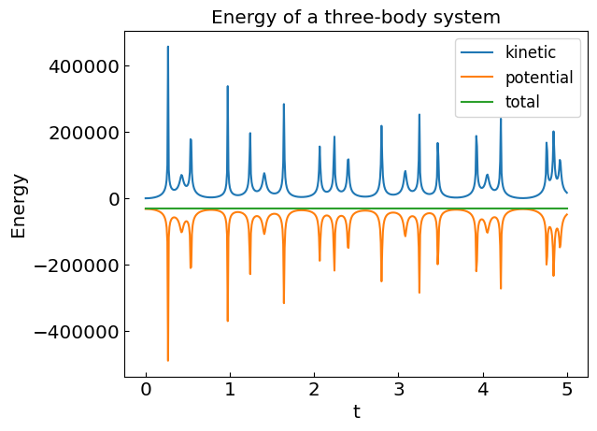
Three-body problem
Run from t = 0 to 5
final project idea(?): simulate the solar system

Slide 5
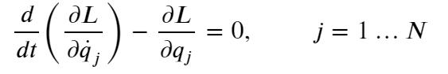
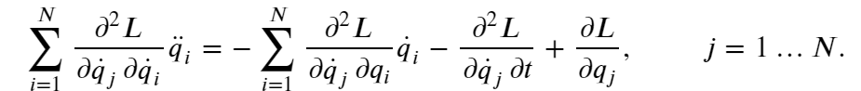
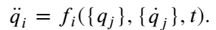
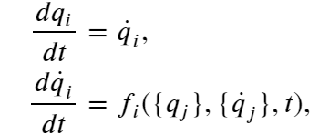
Lagrangian mechanics
In Lagrangian mechanics, a classical system with N degrees of freedom is characterized by generalized coordinates q_{j} that obey Euler-Lagrange equations of motion:
L is the non-relativistic Lagrangian which is typically defined as the difference of kinetic and potential energies, L = T $−$ V.
One can rewrite these equations using the chain rule:
This is a system of N linear equations for ${\ddot{q}}_{j}.$ When solved we have
or
which can be solved using standard methods.

Slide 6
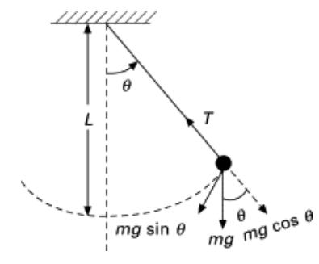
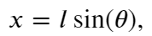
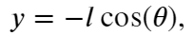
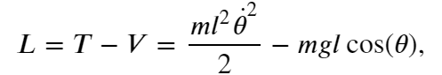
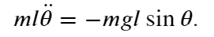
Non-linear pendulum
The generalized coordinate is the displacement angle $θ$
Lagrangian
Equations of motion

Slide 7
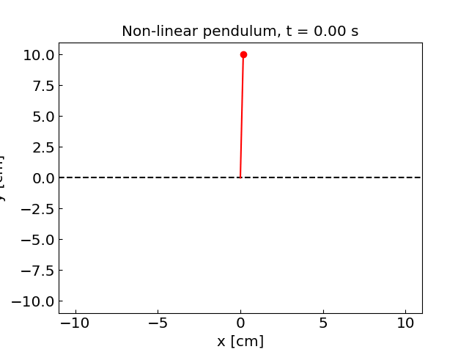
Non-linear pendulum

Slide 8
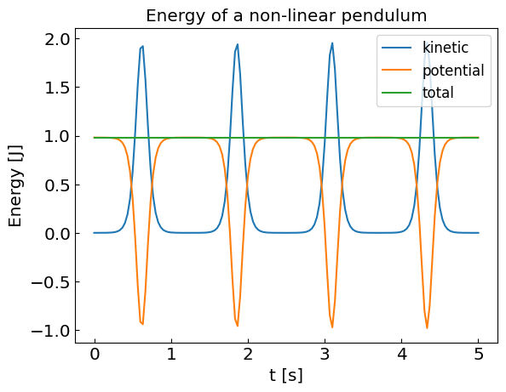
Non-linear pendulum

Slide 9
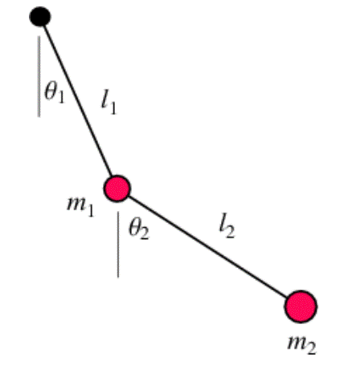
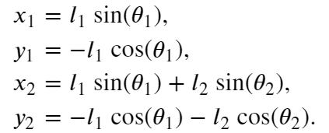
Double pendulum
Double pendulum is the simplest system exhibiting chaotic motion – deterministic chaos
Two degrees of freedom: the displacement angles $θ_{1}$ and $θ_{2}$

Slide 10


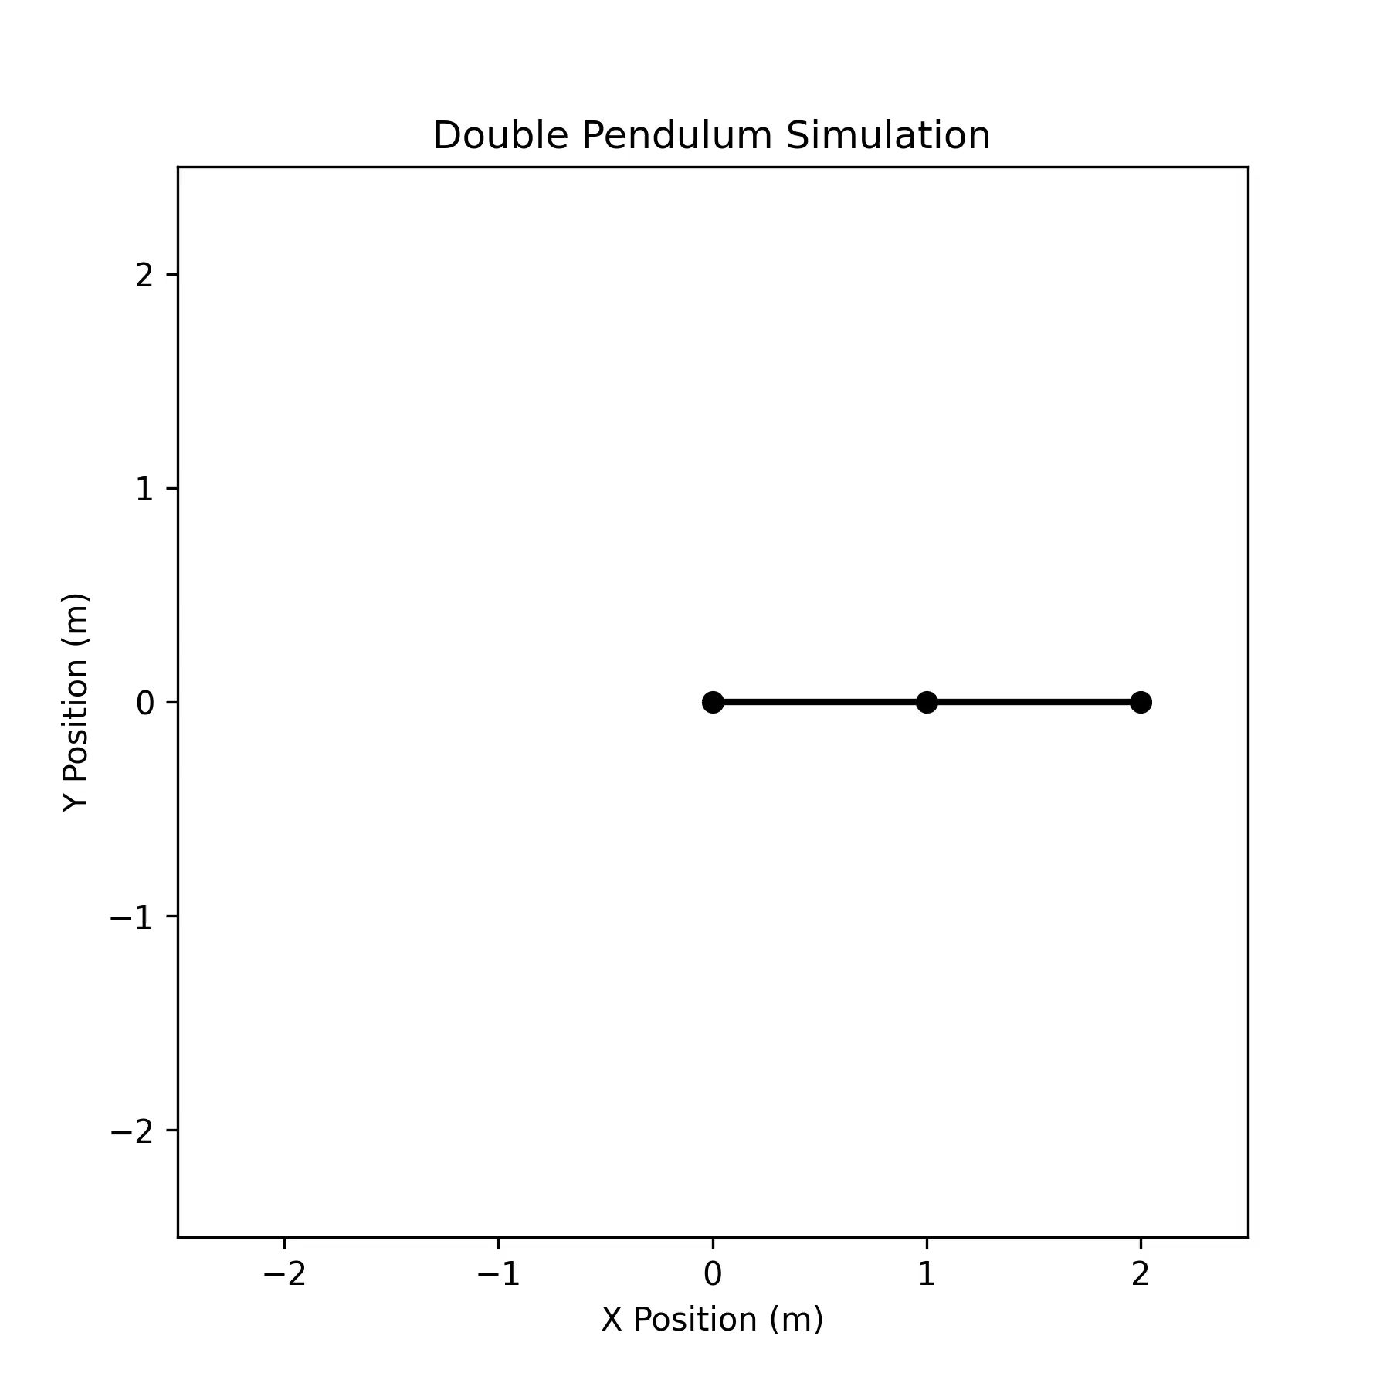

Double pendulum vs ChatGPT
First approach nowadays: try LLM

Slide 11
Double pendulum
Double pendulum is the simplest system exhibiting chaotic motion – deterministic chaos
Two degrees of freedom: the displacement angles $θ_{1}$ and $θ_{2}$
kinetic energy
potential energy

Slide 12
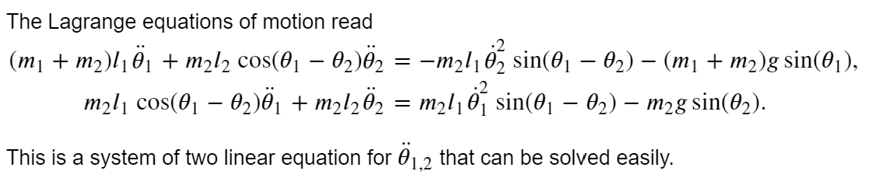
Double pendulum
Double pendulum is the simplest system exhibiting chaotic motion – deterministic chaos
Two degrees of freedom: the displacement angles $θ_{1}$ and $θ_{2}$
kinetic energy
potential energy
The Lagrange equations of motion read
This is a system of two linear equations for ${\ddot{θ}}_{1,2}$ that can be solved straightforwardly.

Slide 13
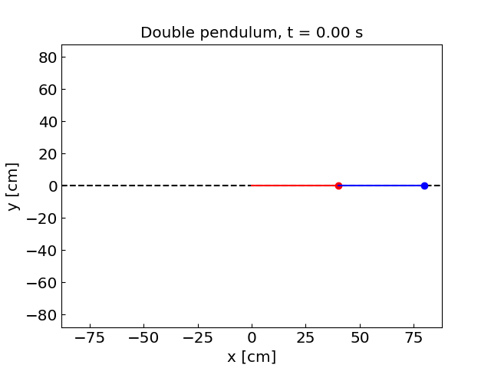
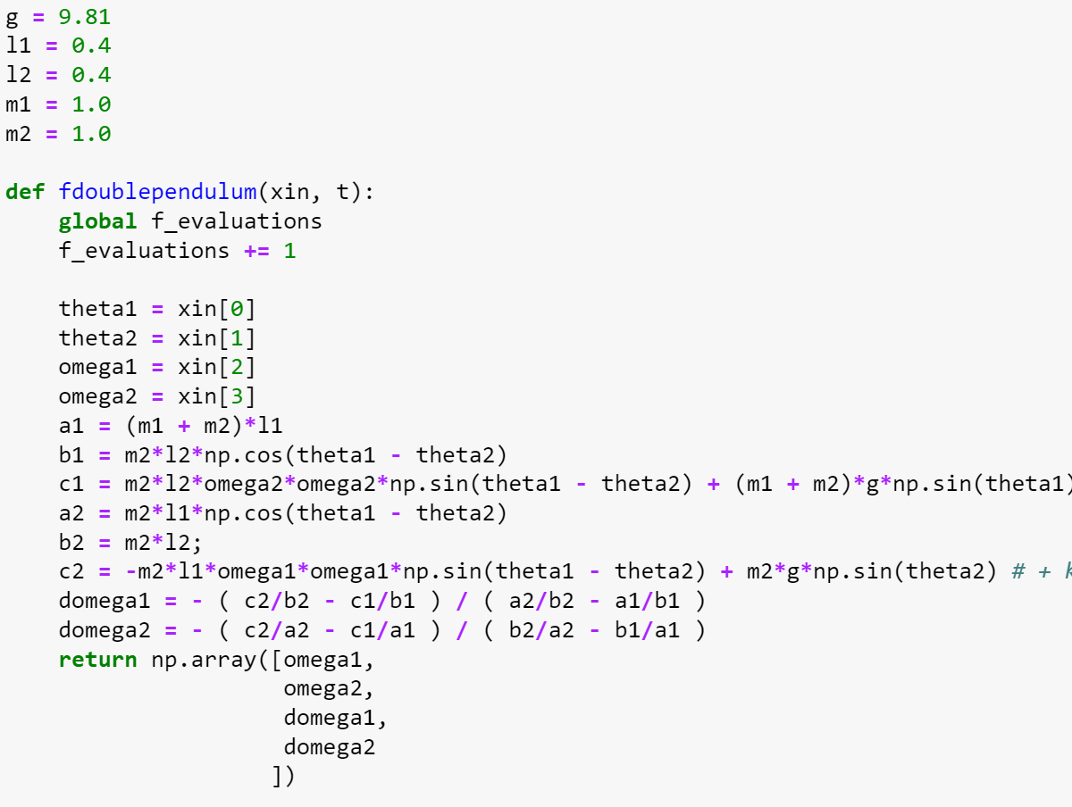
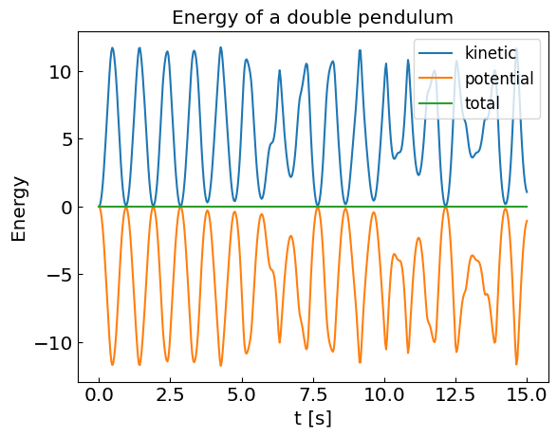
Double pendulum

Slide 14
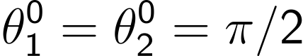
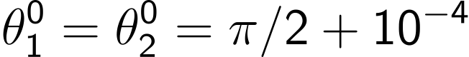

Double pendulum: chaotic behavior

Slide 15
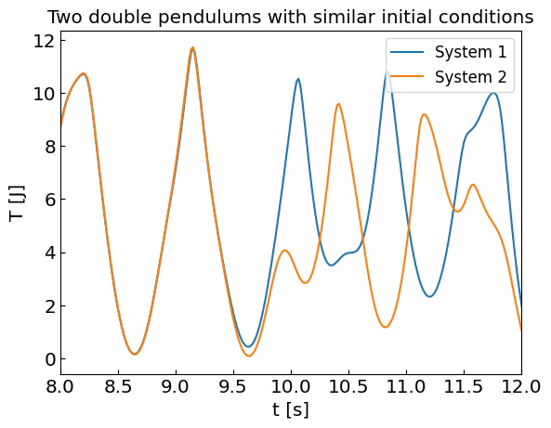
Double pendulum: chaotic behavior

